Slide 1
INTRODUCTION TO NEGOTIATION CONCEPTS
Presented by
Thomas J. Dixon | tom@tomdixon.com
www.DixonCommercialRE.com

Slide 2
Negotiation Concepts
Think of Negotiations as
a Series of Trades
More Trades = Greater Satisfaction
Notes:
Student questions
Ask who likes to negotiate?
Why?
Difference between Salesmanship, Marketing and Negotiation
What makes a negotiation successful?

Slide 3
Negotiation Concepts
“The more we know about negotiation, the better off we are.”
“In business as in life, you don’t get what you deserve, you get what you NEGOTIATE.”
- Dr. Chester L. Karrass
Notes:
All actions personal and business involve negotiations
Personal Examples

Slide 4
Negotiation Concepts
“Knowledge is Power.” -Sir Francis Bacon
The more a person knows about the seller’s cost, organization, business standing and product, the better he can negotiate.
Notes:
Using Google and Public records you can
Find out about the other side.
Financial Condition
Other investments
Family issues

Slide 5
Negotiation Concepts
The 3 stages of negotiation:
Preparation
Action
Agreement

Slide 6
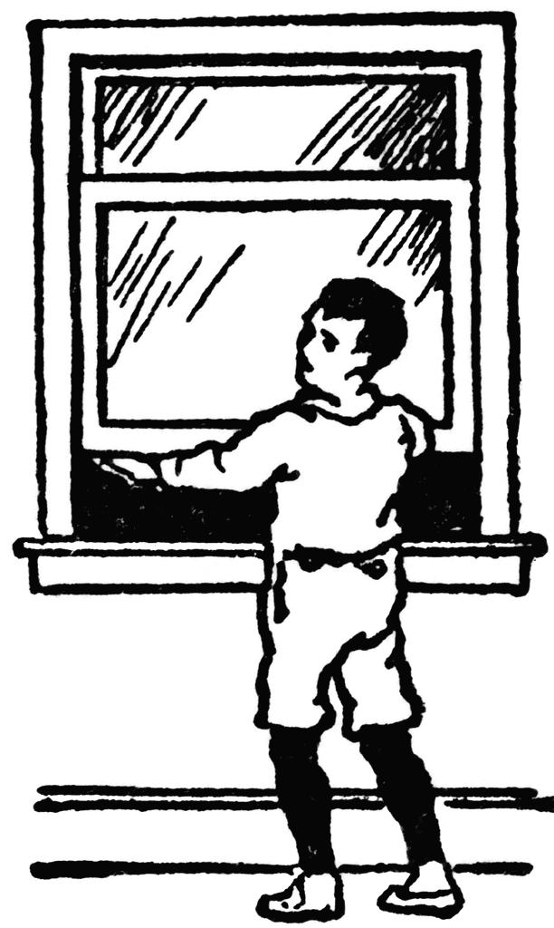
Know the difference between:
Position vs. Interest
Notes:
Use example of window for position interest
Example of stove and carpet damage information on other side

Slide 7
Know the difference between:
Position vs. Interest
Notes:
Use example of window for position interest
Example of stove and carpet damage information on other side

Slide 8
Know the difference between:
Win/Lose and Win/Win
Notes:
Use example of window for position interest
Example of stove and carpet damage information on other side

Slide 9
Notes:
Use example of window for position interest
Example of stove and carpet damage information on other side

Slide 10
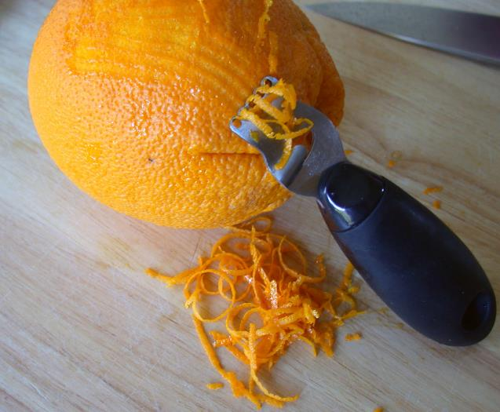
Notes:
Use example of window for position interest
Example of stove and carpet damage information on other side

Slide 11
Gather information and knowledge
of the other side to find:
Their position
Their interest
Notes:
Use example of window for position interest
Example of stove and carpet damage information on other side

Slide 12
What is your position and why?
What are your interests or needs?
Notes:
Why do you want this property
Compare your interest to your needs

Slide 13
Set high goals.
Think about how you can agree.
List ways your proposal benefits the other party’s interests.
Notes:
President Reagan on pay raises

Slide 14
Time Pressure
Notes:
Example of North Vietnam

Slide 15
Time Pressure
Are you or the other side under time pressure to complete the transaction?
Make time pressure be a benefit to your position.
Notes:
Example of North Vietnam

Slide 16
Power
The more options you have,
the greater your power.
List your options.
List their options.
Notes:
Other properties
Stay where you are

Slide 17
Options or Alternatives
Does the other side have alternatives or are we the only option?
Compare your options to theirs?
Notes:
How many options do they have
If you know there options you can be prepared

Slide 18
Information/Market Knowledge
How much market knowledge do you have compared to the other side?
What have they considered or accepted in the past?
Notes:
Comparable Sales or rentals

Slide 19
Range of negotiation
Opening Price
Target vs Acceptable
Maximum or Bottom Line
(Walk away number)
Notes:
First offer might be $2000
Target might be $3000
Maximum $4,000

Slide 20
Create printed support
Practice a dry run
Search for alternatives (yours and theirs)
Prepare comparable information
Notes:
Have exhibits to show options
Have comparable sales or rentals

Slide 21
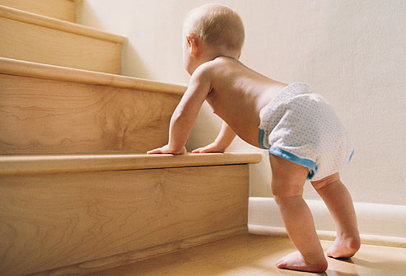
The 90-10 Rule
Spend 90% of time on matters of little importance (go slow!)
Notes:
Explore the personalities for areas of agreement.
The more you talk the better you understand their needs
Non-Americans have different attitudes

Slide 22
Look for their
“Hot Buttons”
“I have to have”s
Notes:
Explore the personalities for areas of agreement.
The more you talk the better you understand their needs
Non-Americans have different attitudes

Slide 23
RESPECT MY
AUTHORITAH!
TACTICS AKA GAMBITS
Authority
Keep your authority limited, negotiate with people with the authority to make decisions.
Take negotiations back to your higher authority.
Notes:
Know their level of authority
If you like the property can you make a buy decision?

Slide 24
TACTICS AKA GAMBITS
Legitimacy
“I can’t, it’s a policy.”
Limited Authority
“I would like to, but I’m not authorized.”
Notes:
This applies more to retail items
Well who has the authority?

Slide 25
TACTICS AKA GAMBITS
The Flinch
“You are asking how much?!”
Notes:
With visual expression
Loan committee

Slide 26
TACTICS AKA GAMBITS
Good Guy/Bad Guy
“I would like to but they won’t approve.”
Notes:
With visual expression
Loan committee

Slide 27
TACTICS AKA GAMBITS
The Krunch
“But that is more than I want to spend.
Can’t you do better?”
“What more can we do?”
“There must be some flexibility in your price.”
Notes:
These apply more to retail items
A gentle way to ask for a price reduction

Slide 28
TACTICS AKA GAMBITS
Responses to The Krunch
“Exactly how much better than that do I have to do?”
“What are you prepared to pay”?
Notes:
Is some asks for a price reduction this could be a reply

Slide 29
TACTICS AKA GAMBITS
The Bogey
“But, this is all I’ve got.”
Notes:
Overcoming Bogey What if I found exactly what you wanted but at a higher price?
Point out flaws as a diversion
Request more that you want or need so you have something to give

Slide 30
TACTICS AKA GAMBITS
Overcoming “The Bogey”
“If I found a much better property at a higher price could you raise more cash?”
Notes:
Overcoming Bogey What if I found exactly what you wanted but at a higher price?
Point out flaws as a diversion
Request more that you want or need so you have something to give

Slide 31
TACTICS AKA GAMBITS
Straw Issues
“Ask for more than you want.”
Notes:
Overcoming Bogey What if I found exactly what you wanted but at a higher price?
Point out flaws as a diversion
Request more that you want or need so you have something to give

Slide 32
TACTICS AKA GAMBITS
The Hairy Hand
Notes:
Point out flaws as a diversion

Slide 33
TACTICS AKA GAMBITS
Funny Money
Measure money in other terms
Price per item
Price over time
Notes:
Example of bed sheet. It costs $1,200 but will last 3 years so it is only $1.10 per day or $.55 for the each of you..

Slide 34
TACTICS AKA GAMBITS
The Nibble
After everything has been agreed and you are ready to sign.
“Oh, just one more thing.”
Notes:
Detective Colombo “oh by the way” as he is leaving
That does include a full tank of gas?

Slide 35
First Action
Have the other side make the first offer.
Start with a high goal,
the higher you aim the
better you will come out.
Notes:
Reagan government pay raise

Slide 36
First Action
Don’t say “yes” or accept too soon.
A buyer who talks price first
has already mentally agreed to buy.
Notes:
Buying a used car or computer

Slide 37
Opening Questions on Price
How did you arrive at that price?
Would you accept $?
Is that the best you can do?
What else does that include?
Notes:
Buying a used car or computer

Slide 38
The 3 F’s (to avoid disagreements)
Feel - I know how you feel…
Felt - Others have felt the same…
Found - I have found that…
Notes:
Example of Diesel Car
Buying a older property

Slide 39
Rule of Halves
“Each concession only moves you half way from you present position to your target.”
Notes:
Have the opposite offer to split or halve the difference
I will pay $100,000 but you want $125,000 ??

Slide 40
Movement
Find high-value / low cost concessions to trade.
Settle multiple issues as a package at the end.
Agree in writing.
Notes:
Couch and end table

Slide 41
Movement
Give big concessions in the beginning,
then smaller ones.
Discuss the small things first.
Find areas of agreement.
Notes:
If concession get bigger the opposite will want to get more

Slide 42
Movement
Interested Buyers will express reasons to reject the property.
Non-buyers love everything about the property. Or say nothing.
Notes:
Buyer who examine and comment are more interested.

Slide 43
Write your own memo of agreement.
Shut up.
Be ready to walk away and walk back.
Notes:
Write up agreements as they occur
Always be prepared to give up and come back
Call me if you change your mind

Slide 44
Overcoming a Deadlock
What issues have been agreed to?
What issues are still open and un-discussed?
What issues are in disagreement?
Notes:
List on paper if possible

Slide 45
Overcoming a Deadlock
Find common ground at a personal level.
Introduce new information.
Change negotiator.
Notes:
Discuss not purchase issues
New comparable sales

Slide 46
Overcoming a Deadlock
Change the element of risk.
Change the element of money.
Caucus - take a break.
Notes:
Change risk offer more deposit, shorter inspection
Higher price with PMM
Fewer contingencies

Slide 47
Overcoming a Deadlock
Offer minor concessions.
Present “What If” Scenarios
“If you change your mind call me.”
Notes:
Would you if I can get my side to accept

Slide 48
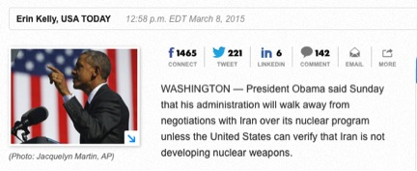
Walk Away
Notes:
Would you if I can get my side to accept

Slide 49
Changes after agreement
Acceptance subject to higher authority.
Counter-offer is higher.
Counter-offer has more conditions.
Notes:
Always need to go to higher authority
Example of buying condo

Slide 50
Final Thoughts
Don’t make a concession without getting something in return.
If you give …get.
Avoid saying “No”
“Yes, if” is always better.
Notes:
Call Girl principal

Slide 51
Further Learning
“It’s not what can I get them to give me. It’s what I can give them that would not take away from my position that may be of value to them.”
- Dr. Chester L. Karrass

Slide 52
Further Learning
“When you give people what they want, they’ll give you what you want.”
- Dr. Chester L. Karrass

Slide 53
Further Learning
“Secret of Power Negotiating” by Roger Dawson
“Tips and Traps When Negotiating Real Estate” by Robert Irwin
“Negotiate to Win” by Jim Thomas
www.Youtube.com videos on Negotiations
www.Youtube.com videos “How2Win”

